Slide 1


Did jacob wohl send death threats to himself?
Mohammed Nauman Siddique
Web Archiving Forensics (CS 895)
Spring, 2019
Web Science and Digital Libraries Group
Old Dominion University
Norfolk, Virginia, USA
@WebSciDL
2019/03/20

Slide 2
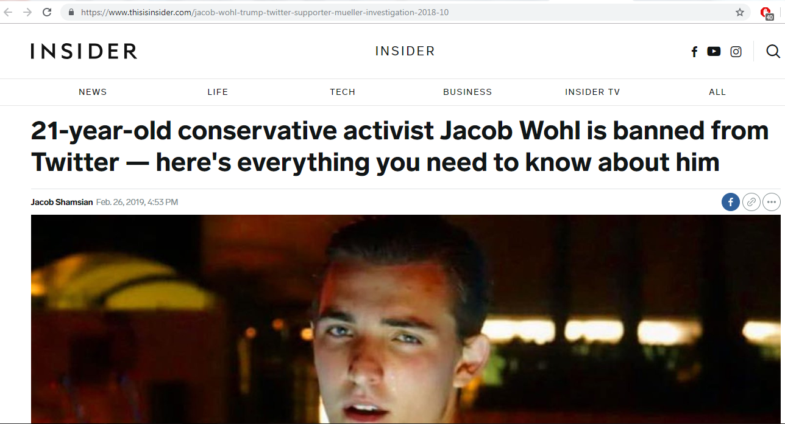
All you need to know about Jacob Wohl
Source: https://www.thisisinsider.com/jacob-wohl-trump-twitter-supporter-mueller-investigation-2018-10

Slide 3
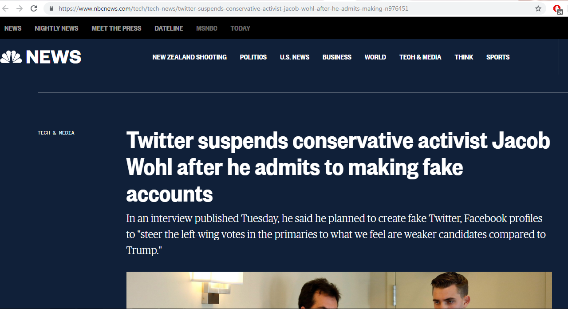
Twitter suspends Jacob Wohl
Source: https://www.nbcnews.com/tech/tech-news/twitter-suspends-conservative-activist-jacob-wohl-after-he-admits-making-n976451

Slide 4
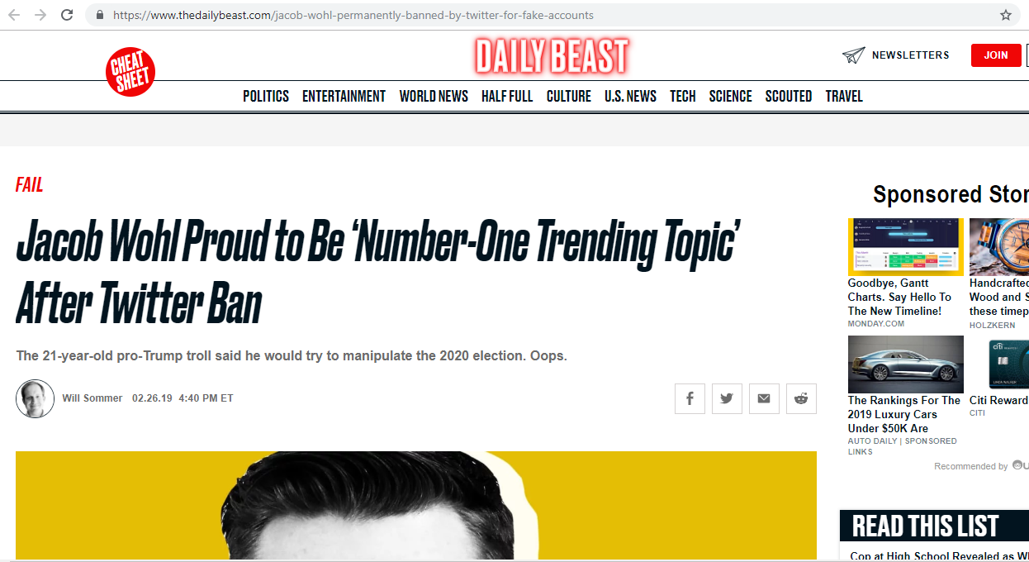
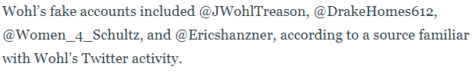
Daily Beast reports Wohl’s fake Twitter accounts
Source: https://www.thedailybeast.com/jacob-wohl-permanently-banned-by-twitter-for-fake-accounts

Slide 5
Jacob Wohl’s fake Twitter account suspended
msiddique@wsdl-3102-03:/$ curl -I https://twitter.com/Women_4_Schultz
HTTP/1.1 302 Found
cache-control: no-cache, no-store, must-revalidate, pre-check=0, post-check=0
content-length: 103
content-type: text/html;charset=utf-8
date: Tue, 19 Mar 2019 05:39:18 GMTexpires: Tue, 31 Mar 1981 05:00:00 GMT
last-modified: Tue, 19 Mar 2019 05:39:18 GMT
location: https://twitter.com/account/suspended
…Deletia…

Slide 6
@Women_4_Schultz has no mementos
msiddique@wsdl-3102-03:/$ curl -I https://memgator.cs.odu.edu/timemap/link/https://twitter.com/Women_4_Schultz
HTTP/1.1 404 Not Found
Access-Control-Allow-Origin: *Access-Control-Expose-Headers: Link, Location, X-Memento-Count, X-Generator
Content-Length: 19
Content-Type: text/plain; charset=utf-8
Date: Tue, 19 Mar 2019 05:42:55 GMT
X-Content-Type-Options: nosniff
X-Generator: MemGator:1.0-rc7
X-Memento-Count: 0

Slide 7
@JWohlTreason has no mementos
msiddique@wsdl-3102-03:/$ curl -I https://memgator.cs.odu.edu/timemap/link/https://twitter.com/JWohlTreason
HTTP/1.1 404 Not Found
Access-Control-Allow-Origin: *Access-Control-Expose-Headers: Link, Location, X-Memento-Count, X-Generator
Content-Length: 19
Content-Type: text/plain; charset=utf-8
Date: Tue, 19 Mar 2019 08:45:07 GMT
X-Content-Type-Options: nosniff
X-Generator: MemGator:1.0-rc7
X-Memento-Count: 0

Slide 8
@Ericshanzner has no mementos
msiddique@wsdl-3102-03:/$ curl -I https://memgator.cs.odu.edu/timemap/link/https://twitter.com/Ericshanzner
HTTP/1.1 404 Not Found
Access-Control-Allow-Origin: *Access-Control-Expose-Headers: Link, Location, X-Memento-Count, X-Generator
Content-Length: 19
Content-Type: text/plain; charset=utf-8
Date: Tue, 19 Mar 2019 08:48:43 GMT
X-Content-Type-Options: nosniff
X-Generator: MemGator:1.0-rc7
X-Memento-Count: 0

Slide 9
Jacob Wohl’s Twitter account is suspended
msiddique@wsdl-3102-03:/$ curl -I https://twitter.com/JacobAWohl
HTTP/1.1 302 Found
cache-control: no-cache, no-store, must-revalidate, pre-check=0, post-check=0
content-length: 103
content-type: text/html;charset=utf-8
date: Mon, 18 Mar 2019 17:27:16 GMTexpires: Tue, 31 Mar 1981 05:00:00 GMTlast-modified: Mon, 18 Mar 2019 17:27:16 GMT
location: https://twitter.com/account/suspended
…Deletia…

Slide 10
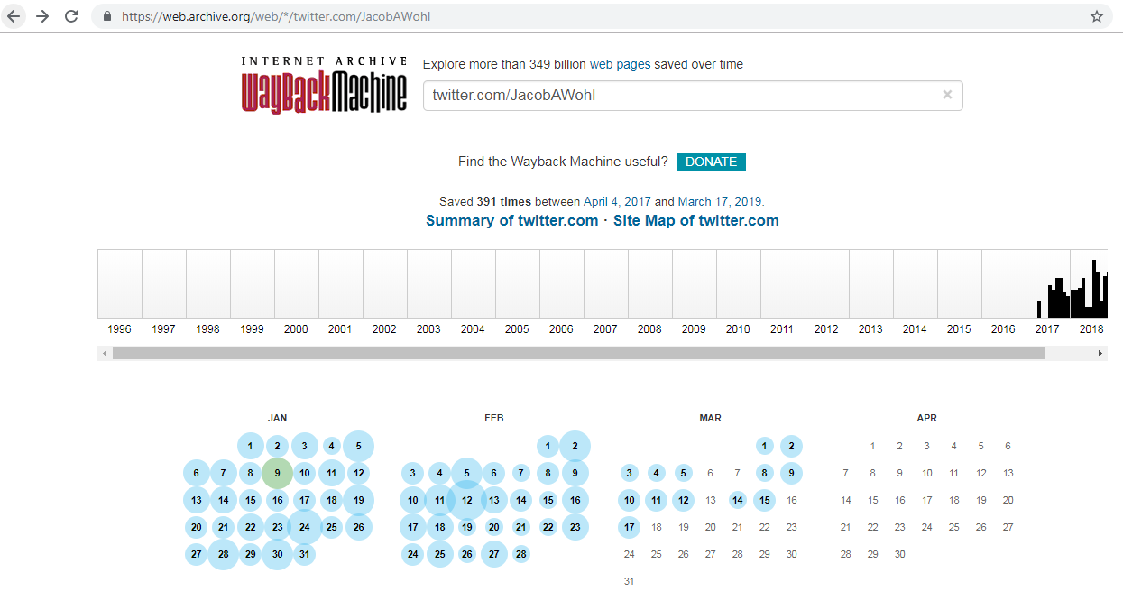
Internet Archive has 319 mementos for @JacobAWohl
Source: https://web.archive.org/web/*/twitter.com/JacobAWohl

Slide 11
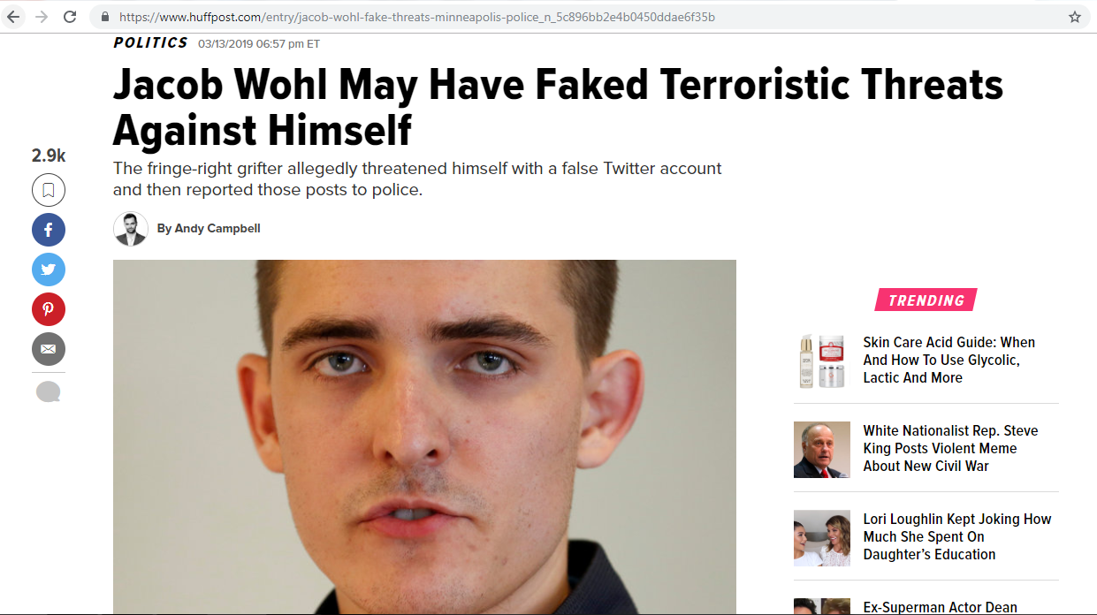
Did Jacob Wohl fake his threat?
Source: https://www.huffpost.com/entry/jacob-wohl-fake-threats-minneapolis-police_n_5c896bb2e4b0450ddae6f35b

Slide 12
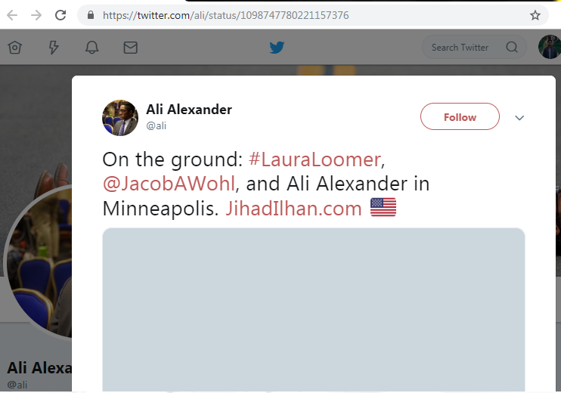
Landed in Minneapolis on 2019-02-21
Source: https://twitter.com/ali/status/1098747780221157376

Slide 13
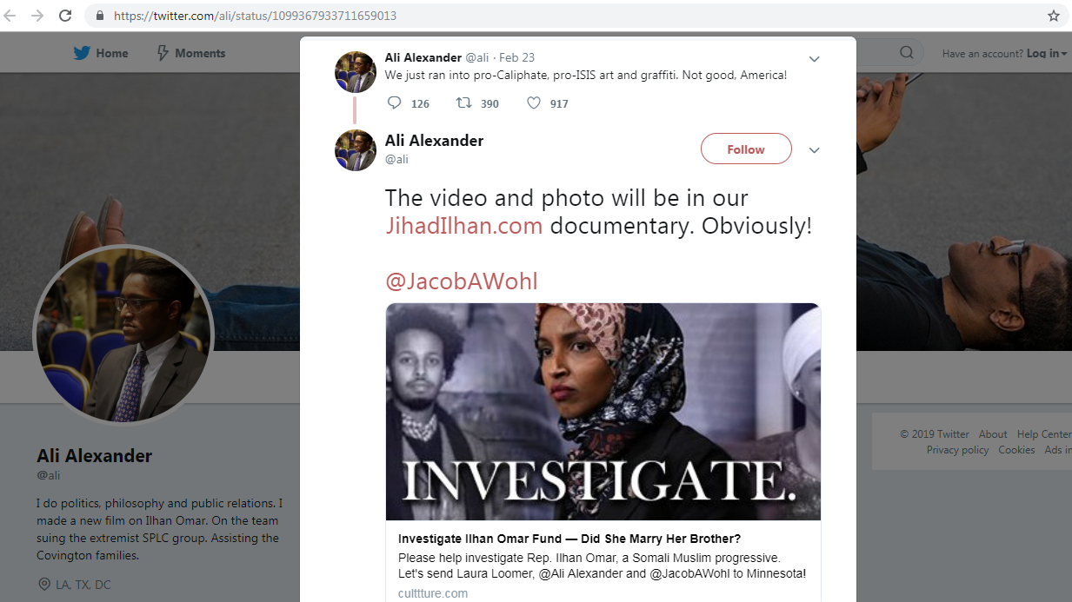
@ali, @JacobAWohl, and @LauraLoomer were filming a documentary on @ilhan
Source: https://twitter.com/ali/status/1099367933711659013

Slide 14
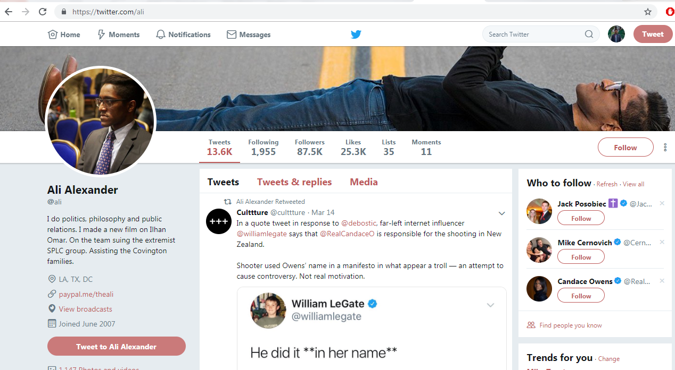
@ali shoots right-wing agenda videos
Source: https://twitter.com/ali

Slide 15

@LauraLoomer is a right-wing investigative journalist (Memento captured just before suspension)
Source: https://web.archive.org/web/20181121135843/twitter.com/lauraloomer

Slide 16
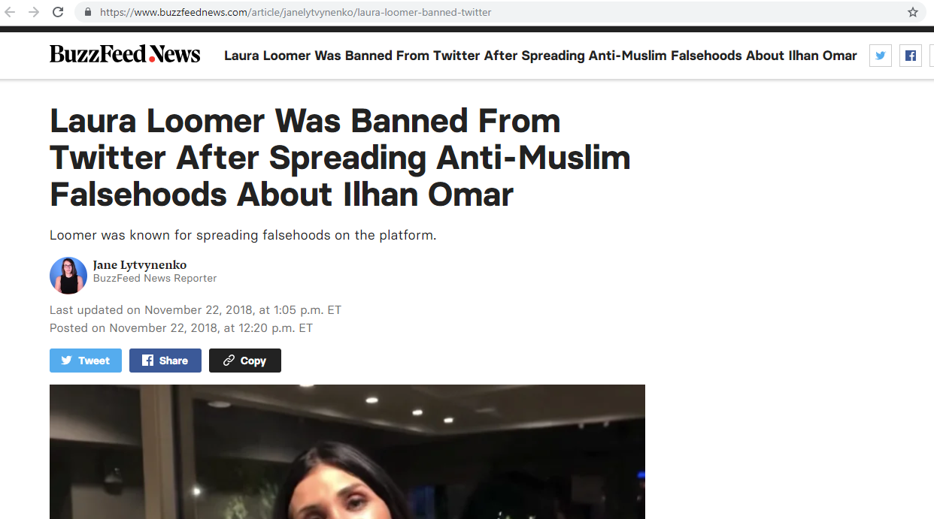
Laura Loomer suspended from Twitter
Source: https://www.buzzfeednews.com/article/janelytvynenko/laura-loomer-banned-twitter

Slide 17
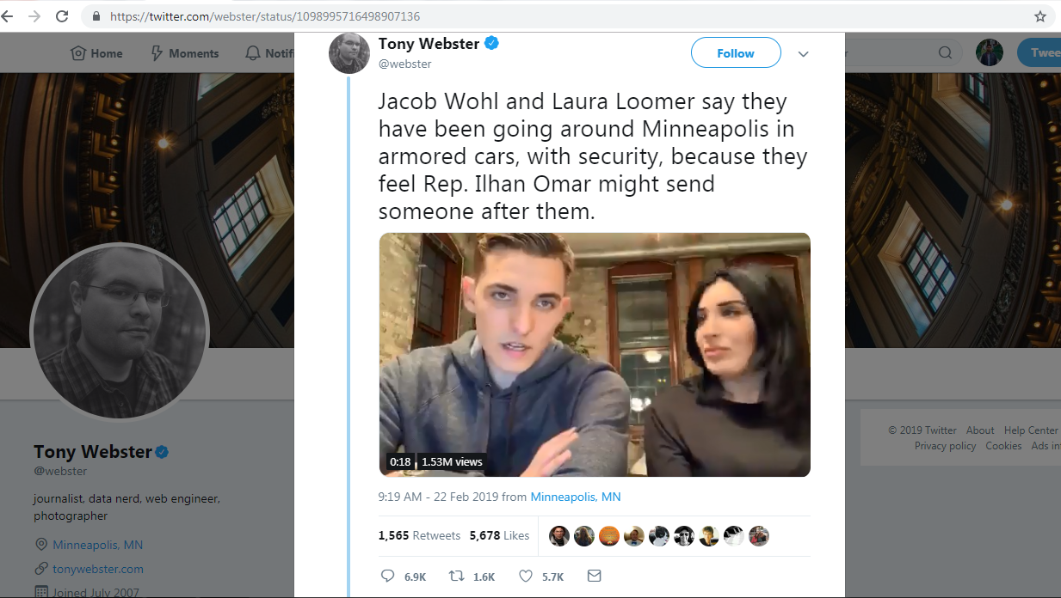
Going around in Minneapolis with security
Source: https://twitter.com/webster/status/1098995716498907136

Slide 18
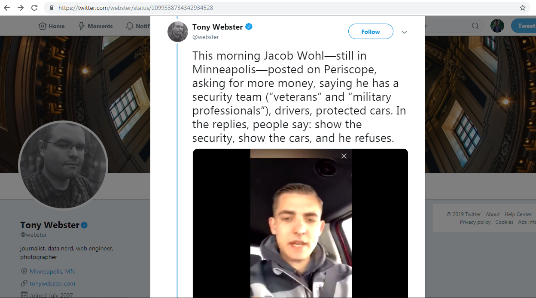
Refuses to show his security
Source: https://twitter.com/webster/status/1099338734342934528

Slide 19
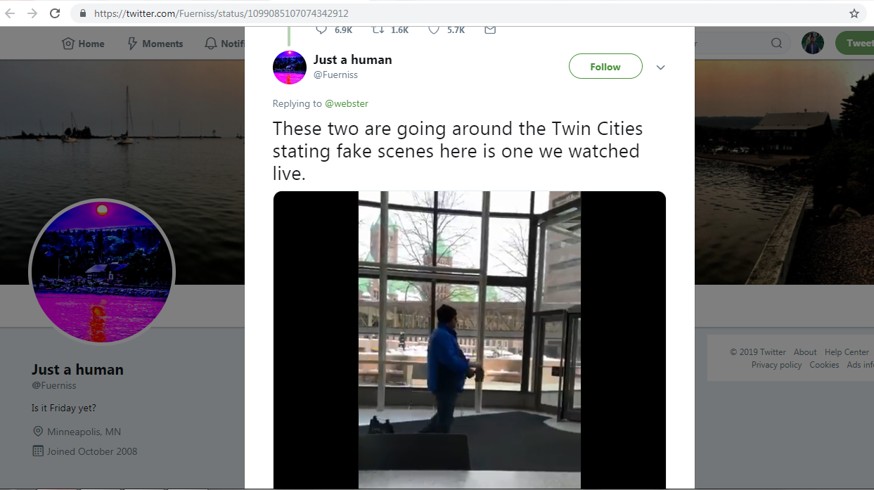
No security to be seen
Source: https://twitter.com/Fuerniss/status/1099085107074342912

Slide 20
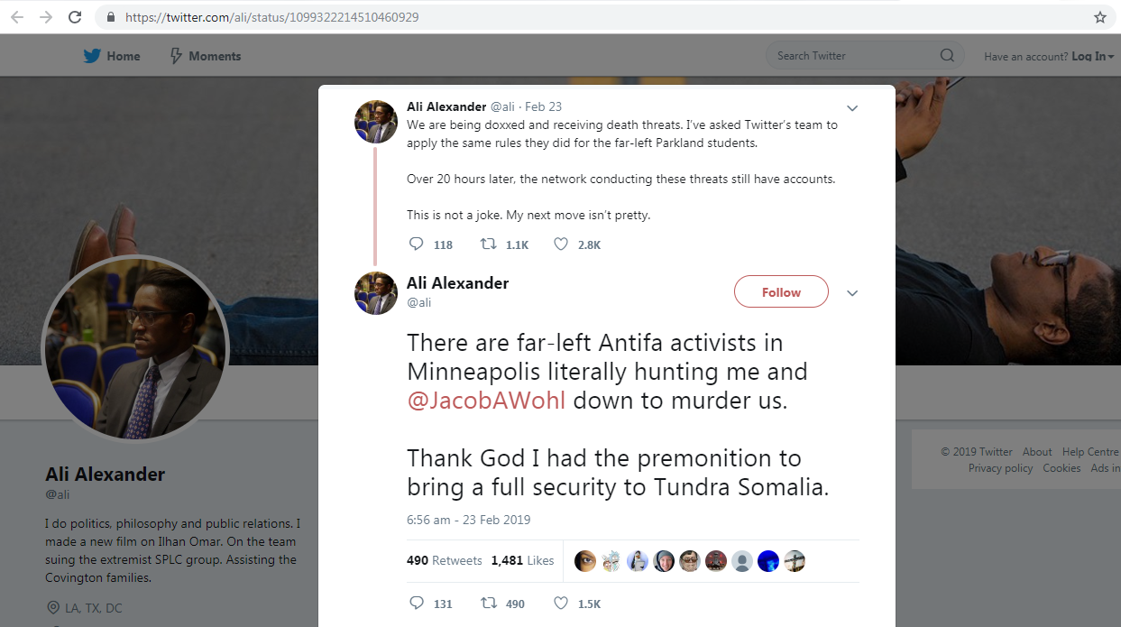
@ali tweets about threats
Source: https://twitter.com/ali/status/1099322214510460929

Slide 21
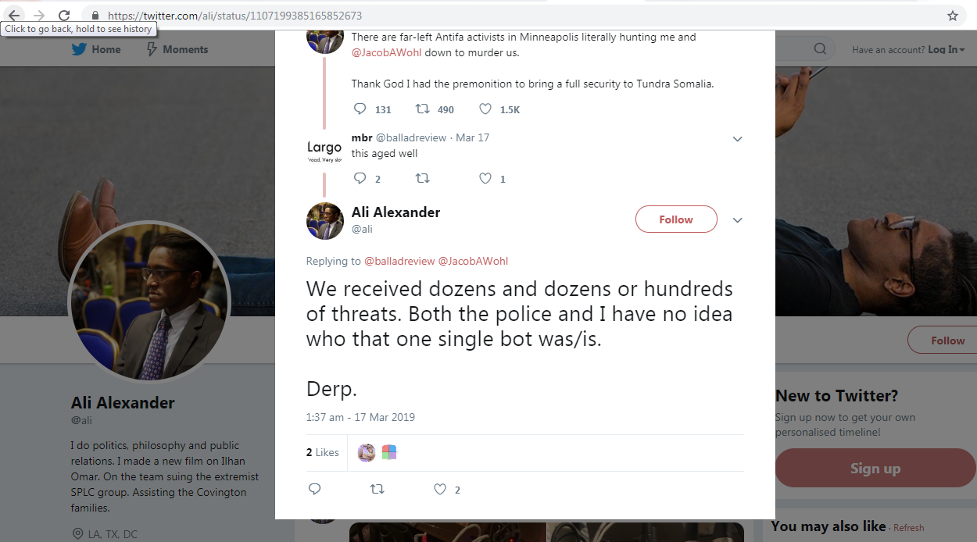
@ali says dozens of threat messages received
Source: https://twitter.com/ali/status/1107199385165852673

Slide 22
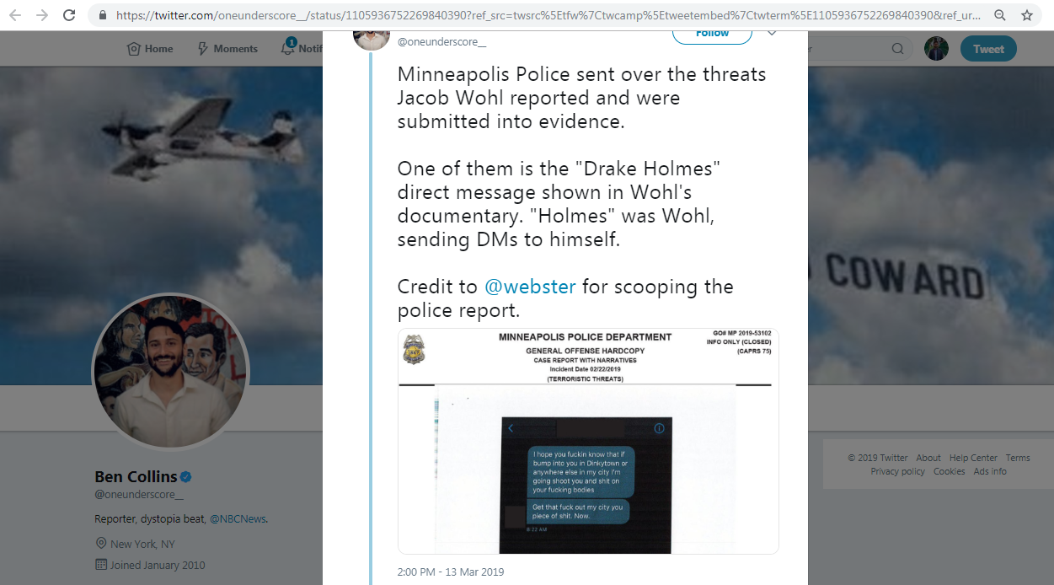
Police report on threat message
Source: https://twitter.com/oneunderscore__/status/1105936752269840390

Slide 23
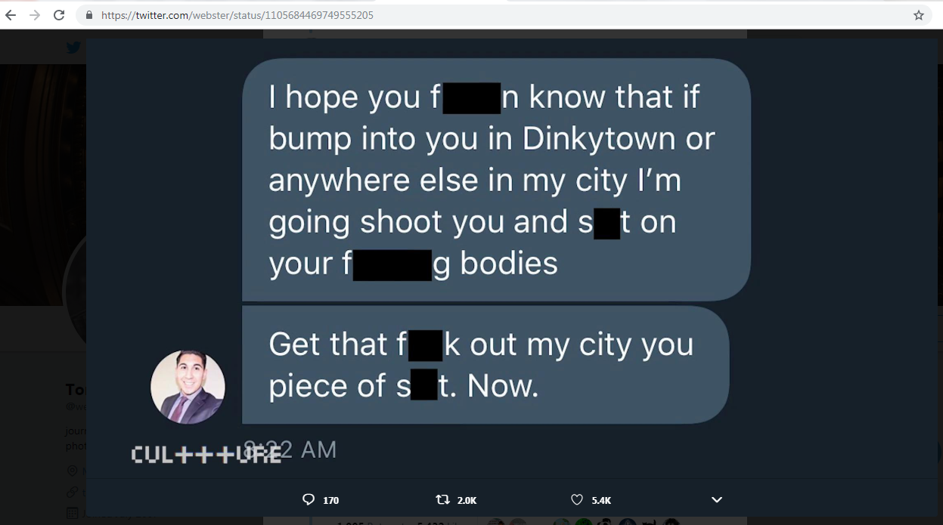
Threat message sent to Jacob Wohl
Source: https://twitter.com/webster/status/1105684469749555205

Slide 24
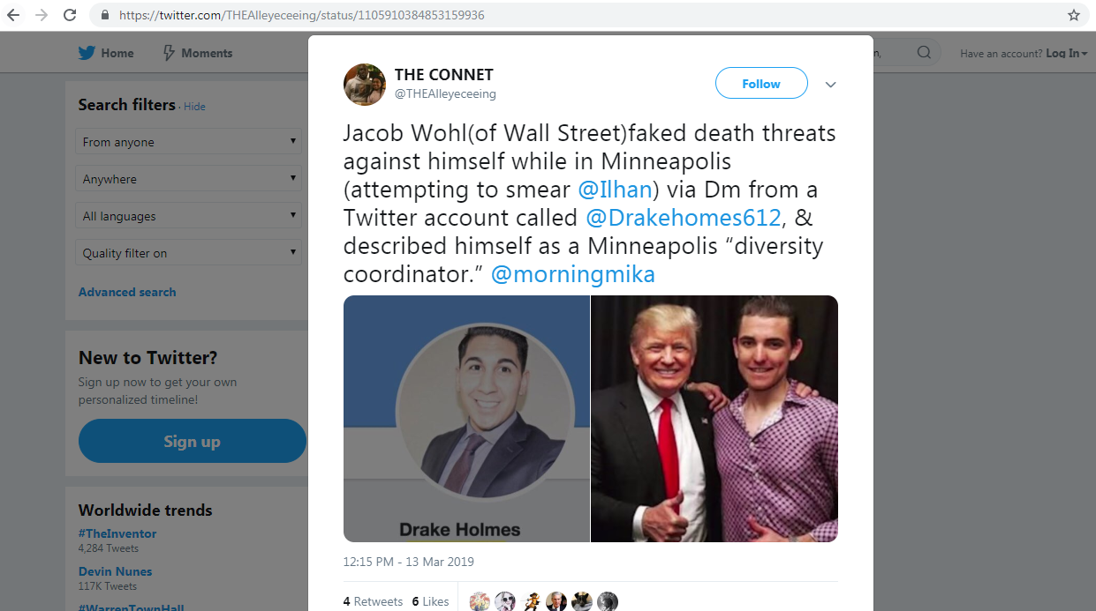
@DrakeHomes612 sends a threat message via DM
Source: https://twitter.com/THEAlleyeceeing/status/1105910384853159936

Slide 25
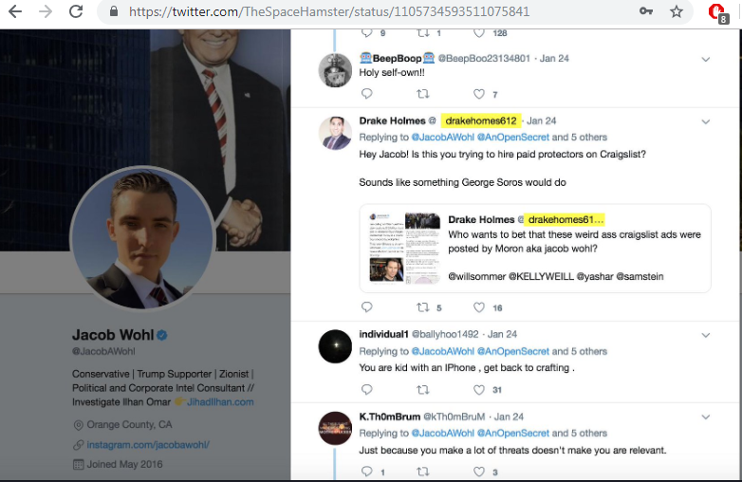
Tweet from @DrakeHomes612 to @JacobAWohl (2019-01-24)
Source: https://twitter.com/TheSpaceHamster/status/1105734593511075841

Slide 26
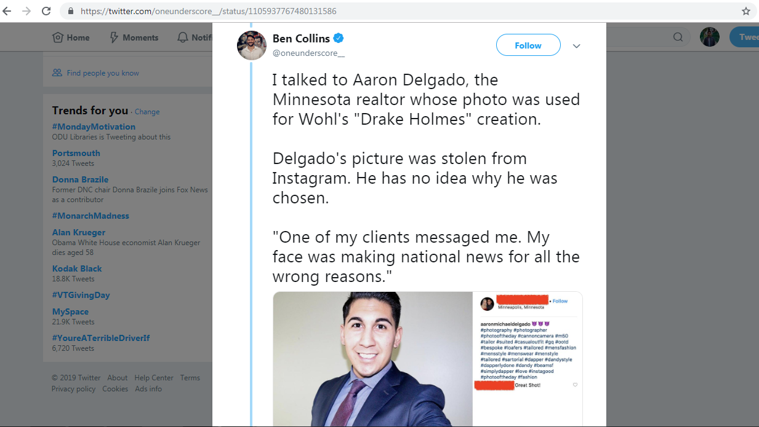
Minnesota Realtor’s photo was used on fake account
Source: https://twitter.com/oneunderscore__/status/1105937767480131586

Slide 27
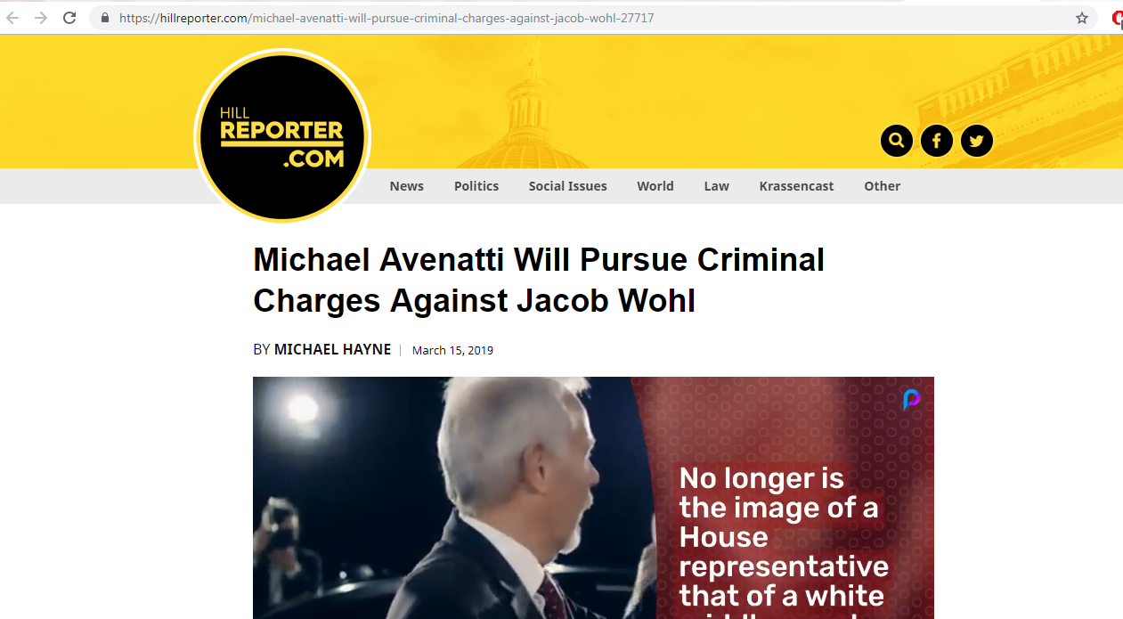
Legal charges will be pressed for impersonation
Source: https://hillreporter.com/michael-avenatti-will-pursue-criminal-charges-against-jacob-wohl-27717

Slide 28
Fake account that sent the threat is suspended
msiddique@wsdl-3102-03:/$ curl -I https://twitter.com/DrakeHomes612
HTTP/1.1 302 Found
cache-control: no-cache, no-store, must-revalidate, pre-check=0, post-check=0
content-length: 103
content-type: text/html;charset=utf-8
date: Mon, 18 Mar 2019 17:31:31 GMTexpires: Tue, 31 Mar 1981 05:00:00 GMT
last-modified: Mon, 18 Mar 2019 17:31:31 GMT
location: https://twitter.com/account/suspended
…Deletia…

Slide 29
No memento for @DrakeHomes612
msiddique@wsdl-3102-03:/$ curl -I https://memgator.cs.odu.edu/timemap/link/https://twitter.com/DrakeHomes612
HTTP/1.1 404 Not Found
Access-Control-Allow-Origin: *Access-Control-Expose-Headers: Link, Location, X-Memento-Count, X-Generator
Content-Length: 19
Content-Type: text/plain; charset=utf-8
Date: Tue, 19 Mar 2019 05:50:28 GMT
X-Content-Type-Options: nosniff
X-Generator: MemGator:1.0-rc7
X-Memento-Count: 0

Slide 30
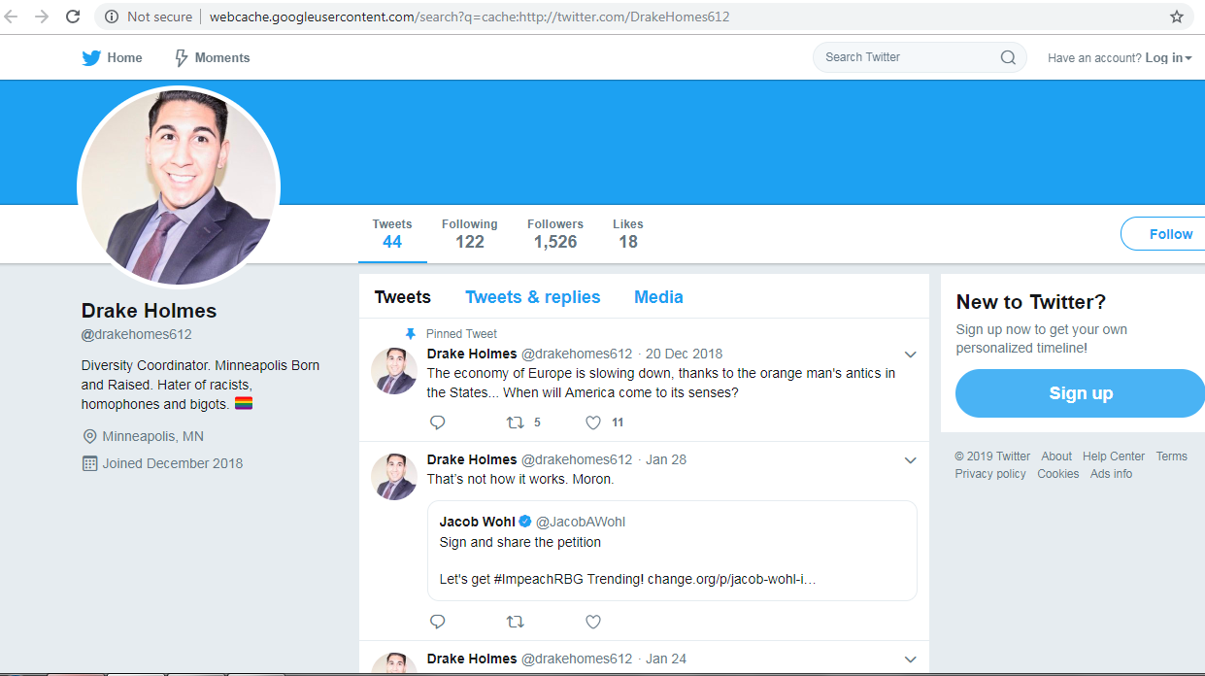
Google cache copy of @DrakeHomes612
Source: http://webcache.googleusercontent.com/search?q=cache:http://twitter.com/DrakeHomes612

Slide 31
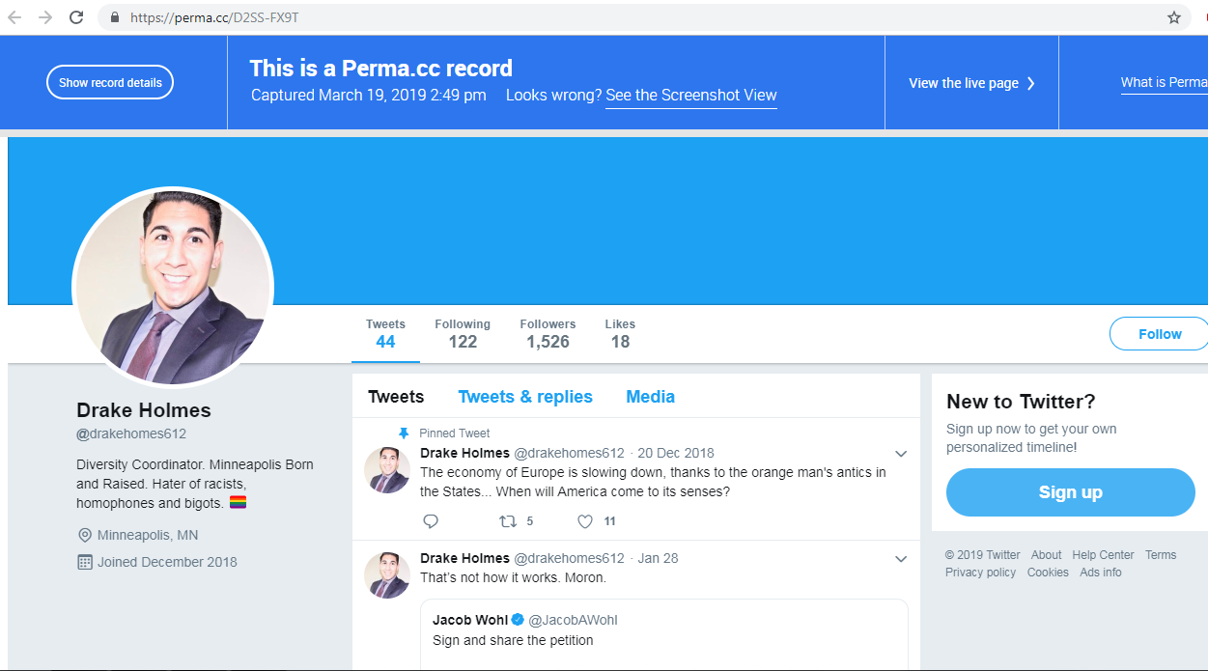
Pushed to perma.cc and archive.is
Perma.cc: https://perma.cc/D2SS-FX9T
Archive.is: http://archive.is/2PbfI

Slide 32
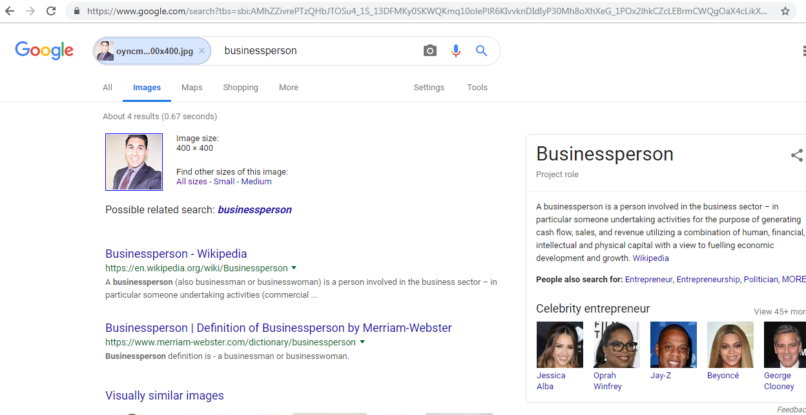
Google reverse image search on @DrakeHomes612 avatar

Slide 33
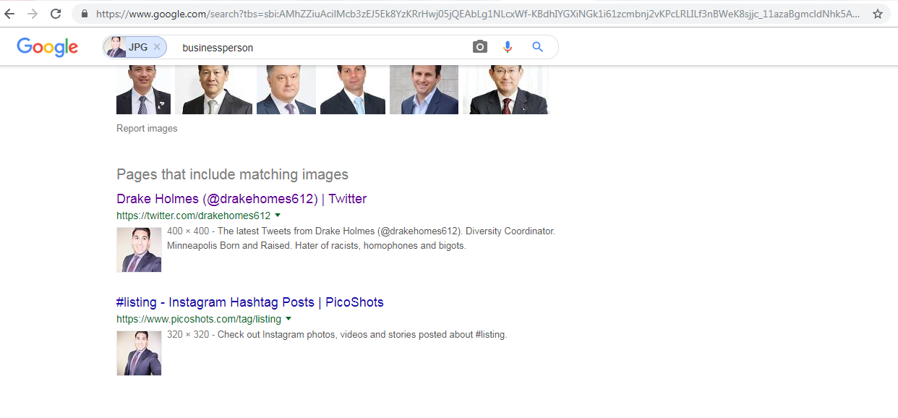
New page with image found at Picoshot

Slide 34
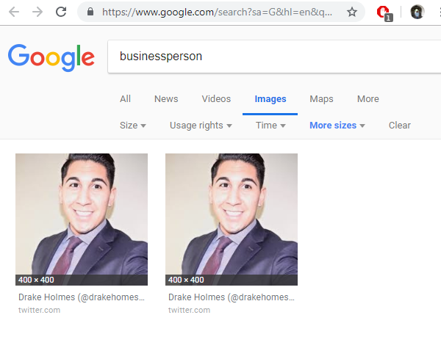
Both images come from Twitter

Slide 35
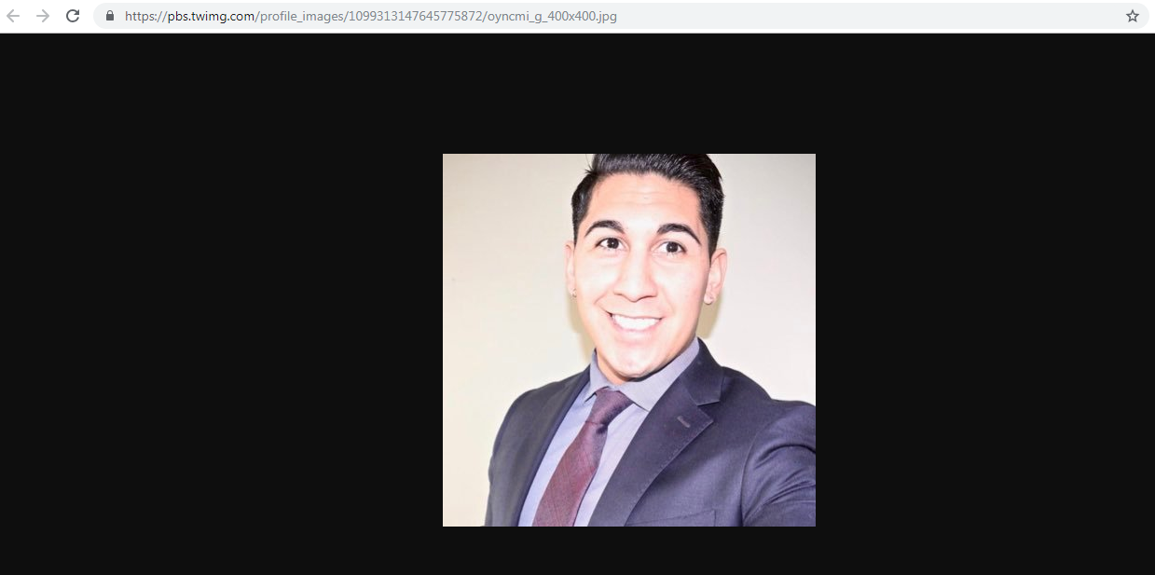
Image is still live
Source: https://pbs.twimg.com/profile_images/1099313147645775872/oyncmi_g_400x400.jpg

Slide 36
Curl on Twitter avatar
msiddique@wsdl-3102-03:/$ curl -I https://pbs.twimg.com/profile_images/1099313147645775872/oyncmi_g_400x400.jpg
HTTP/1.1 200 OK
Accept-Ranges: bytes
access-control-allow-origin: *
access-control-expose-headers: Content-Length
cache-control: max-age=604800, must-revalidate
Content-Type: image/jpeg
Date: Tue, 19 Mar 2019 22:50:13 GMT
Last-Modified: Sat, 23 Feb 2019 14:18:53 GMT
…Deletia…

Slide 37
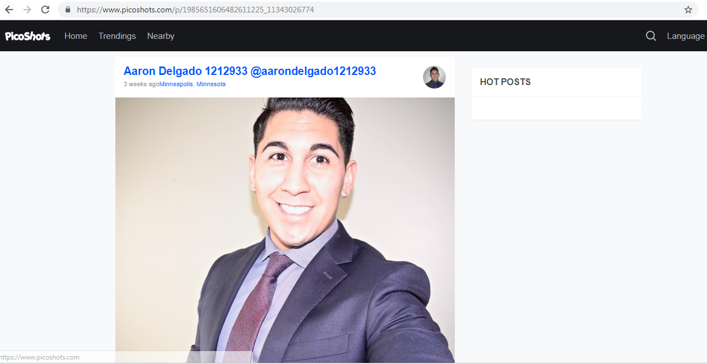
Image from Picoshot
Source: https://www.picoshots.com/p/1985651606482611225_11343026774

Slide 38
Curl on Picoshot image
msiddique@wsdl-3102-03:/$ curl -I https://scontent-sjc3-1.cdninstagram.com/vp/3a3b2018e268ab5ded5c5a20af537920/5D144677/t51.2885-15/e35/51645318_2070296673060819_5829888898148890285_n.jpg?_nc_ht=scontent-sjc3-1.cdninstagram.com&se=7&ig_cache_key=MTk4NTY1MTYwNjQ4MjYxMTIyNQ%3D%3D.2
[1] 29167
[2] 29168
msiddique@wsdl-3102-03:/$ HTTP/1.1 200 OK
Last-Modified: Sat, 23 Feb 2019 13:22:19 GMT
Date: Tue, 19 Mar 2019 23:10:33 GMT
…Deletia….

Slide 39
Picoshot image comes 1 hour earlier than Twitter avatar
msiddique@wsdl-3102-03:/$ curl -I https://pbs.twimg.com/profile_images/1099313147645775872/oyncmi_g_400x400.jpg
Date: Tue, 19 Mar 2019 22:50:13 GMT
Last-Modified: Sat, 23 Feb 2019 14:18:53 GMT
…Deletia…
msiddique@wsdl-3102-03:/$ curl -I https://scontent-sjc3-1.cdninstagram.com/vp/3a3b2018e268ab5ded5c5a20af537920/5D144677/t51.2885-15/e35/51645318_2070296673060819_5829888898148890285_n.jpg?_nc_ht=scontent-sjc3-1.cdninstagram.com&se=7&ig_cache_key=MTk4NTY1MTYwNjQ4MjYxMTIyNQ%3D%3D.2
Last-Modified: Sat, 23 Feb 2019 13:22:19 GMT
Date: Tue, 19 Mar 2019 23:10:33 GMT
…Deletia….

Slide 40
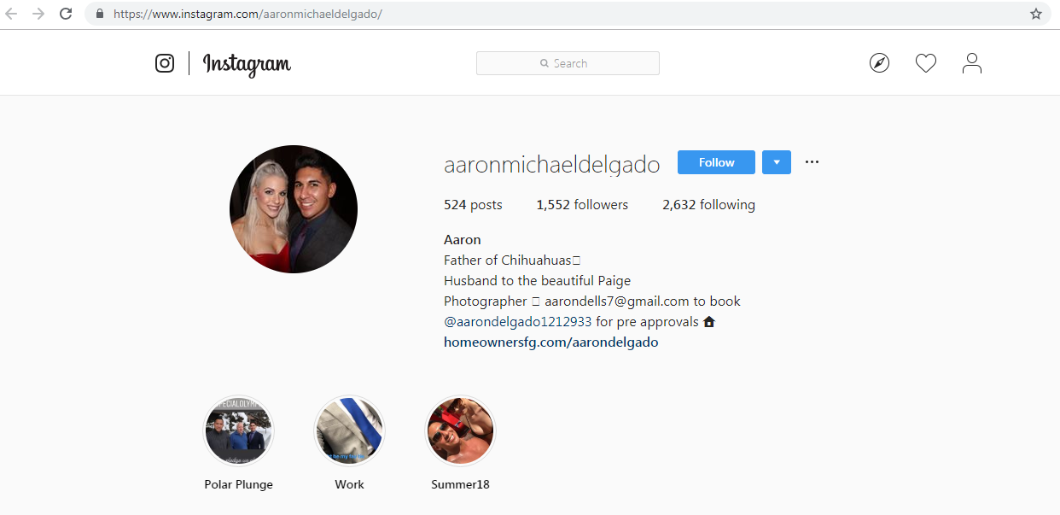
Delgado’s Instagram Profile
Source: https://www.instagram.com/aaronmichaeldelgado/

Slide 41
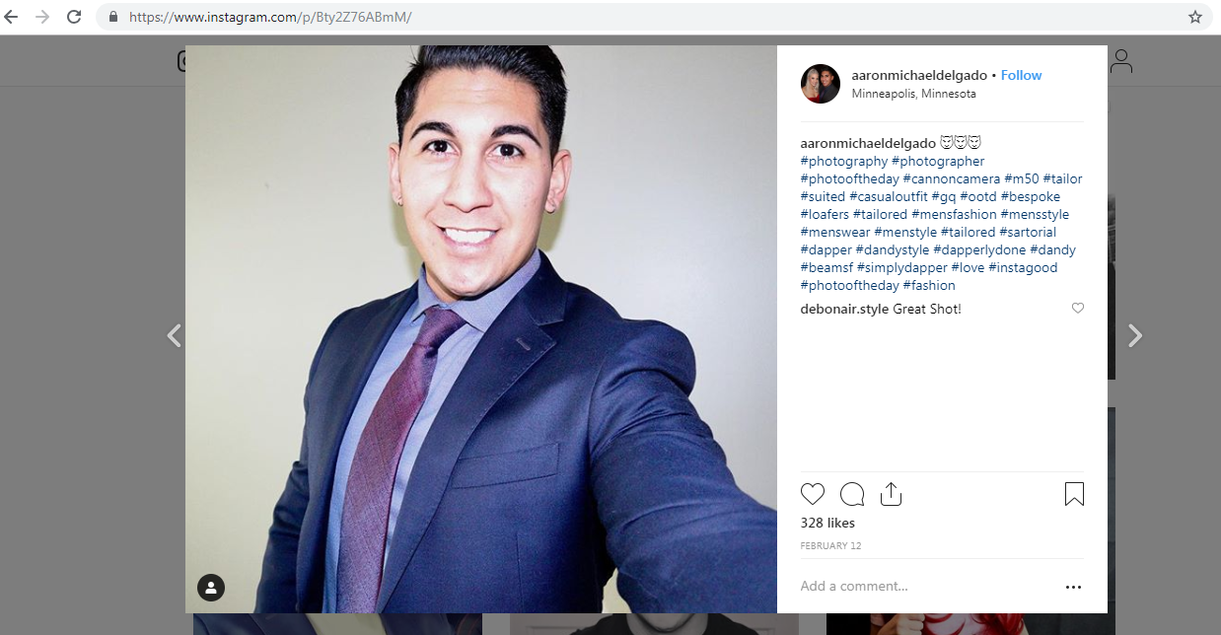
Uploaded to Instagram on 2019-02-12
Source: https://www.instagram.com/p/Bty2Z76ABmM/

Slide 42
Curl Instagram photo
msiddique@wsdl-3102-03:/$ curl -I https://instagram.forf1-2.fna.fbcdn.net/vp/6a32531eb5eb4c1b0eaab2c0692ab940/5D29227A/t51.2885-15/e35/49582903_2332574413638923_5205387116260935407_n.jpg?_nc_ht=instagram.forf1-2.fna.fbcdn.net
HTTP/1.1 200 OK
Last-Modified: Tue, 12 Feb 2019 20:06:25 GMT
Date: Tue, 19 Mar 2019 23:51:12 GMT
Connection: keep-alive
Content-Length: 117133
…Deletia…

Slide 43
Timeline for Delgado’s Image Usage (realtor = holmes = homes)
2019-02-12T20:06:25 - Image uploaded to Instagram
2019-02-23T14:18:53 - Image shows up on Picoshot
2019-02-23T14:18:53 - Image used as Twitter avatar
(Possible Reasoning: the creator of the fake account found the image on Picoshot, a site designed to allow “anonymous” browsing of Instagram, sees that Delgado, who hails from Minneapolis, is both ethnic and attractive, so uses that image for the fake Twitter account.)

Slide 44
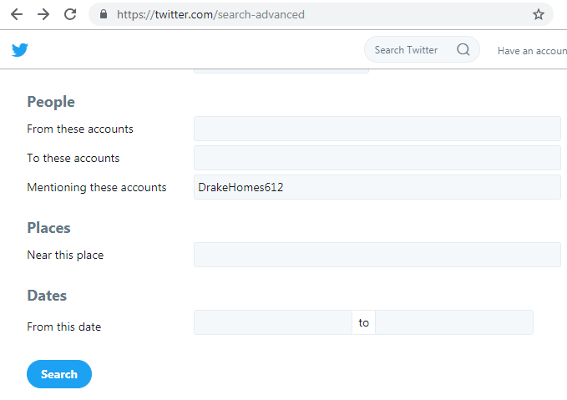
Checking Twitter’s advanced search
Source: https://twitter.com/search-advanced

Slide 45
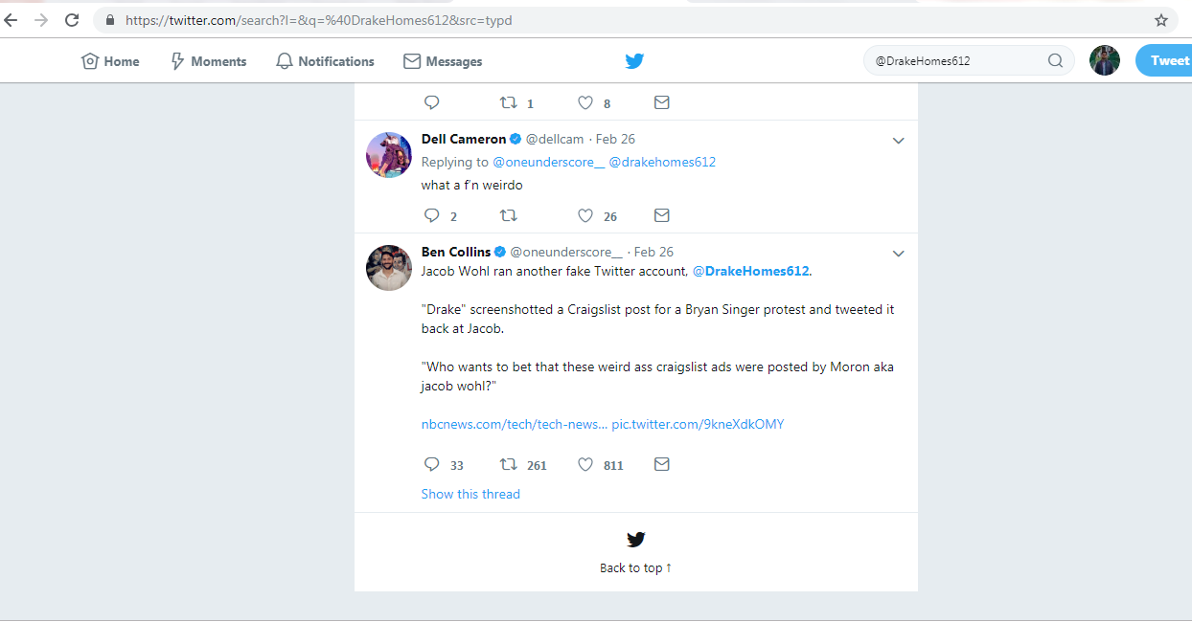
@Drakehomes612 has earliest mention for 2019-02-26

Slide 46
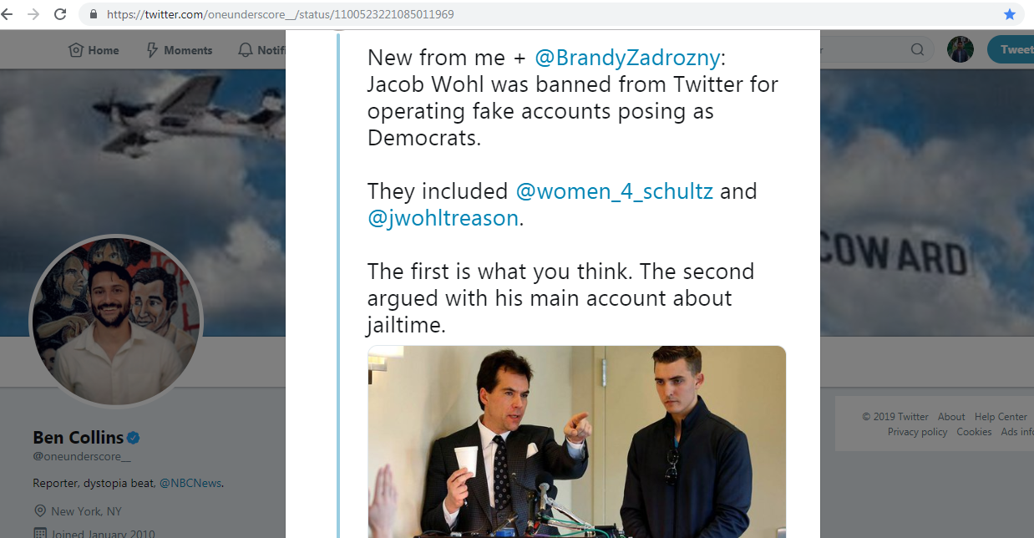
Wohl suspended from Twitter
Source: https://twitter.com/oneunderscore__/status/1100523221085011969

Slide 47
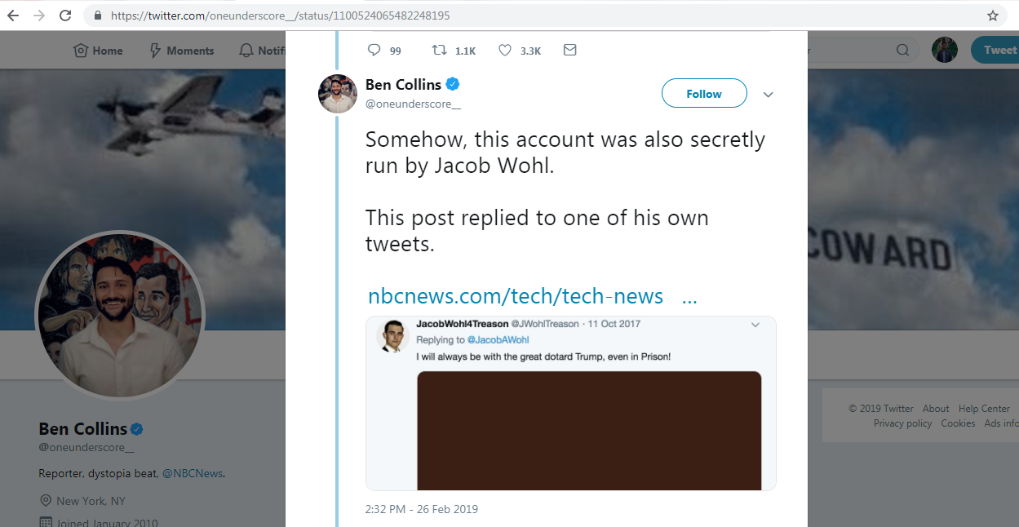
Wohl replies to @JWohlTreason aka himself
Source: https://twitter.com/oneunderscore__/status/1100524065482248195

Slide 48
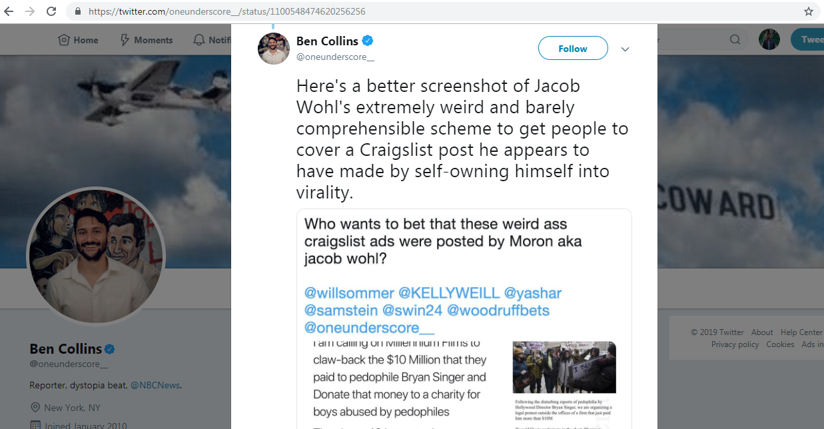
@DrakeHomes612 comments to Wohl
Source: https://twitter.com/oneunderscore__/status/1100548474620256256

Slide 49
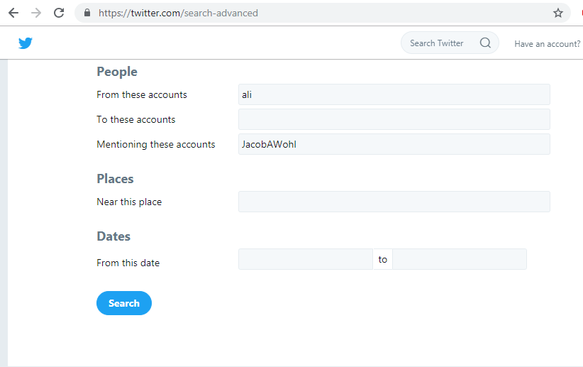
Search for @ali mentioning @JacobAWohl

Slide 50
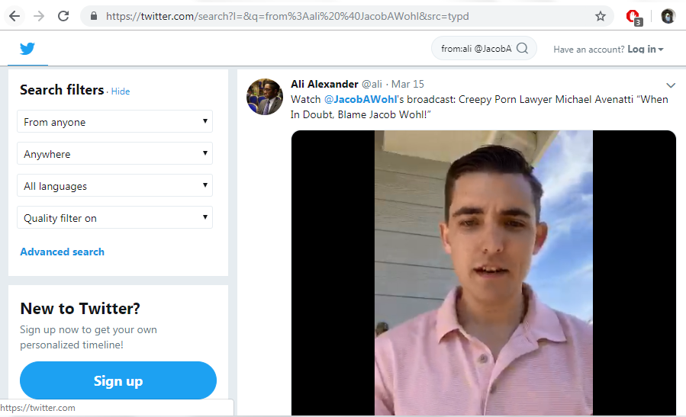
Results date back to 2018-11-04
Source: https://twitter.com/search?l=&q=from%3Aali%20%40JacobAWohl&src=typd

Slide 51
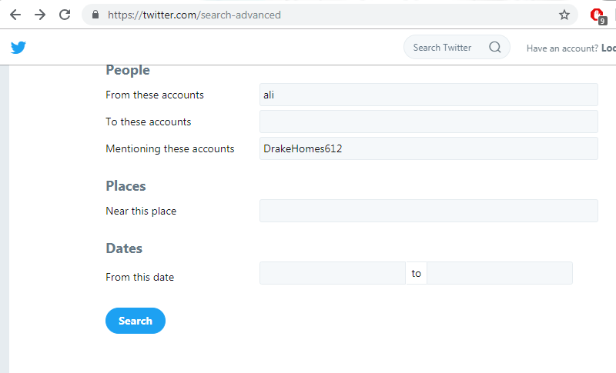
Did @ali mention @Drakehomes612 in his tweets?

Slide 52
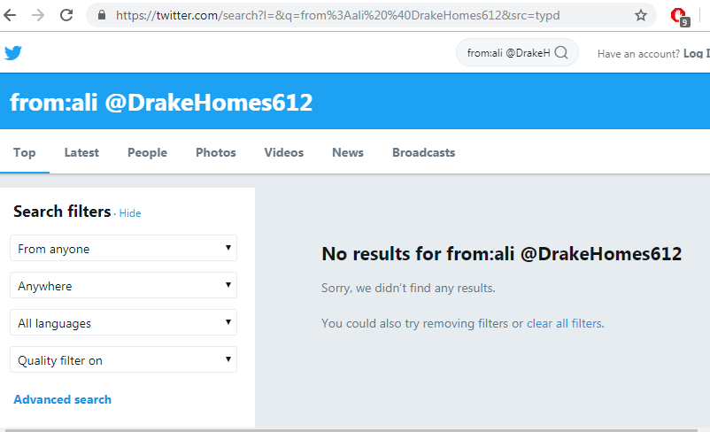
Nope!! No results.

Slide 53
No clear evidence for Wohl threatening himself from @DrakeHolmes612
@DrakeHomes612 was a fake account using Aaron Delgado’s image (Minnesota realtor) as Twitter avatar since 2019-02-23.
It is very plausible that, the image was used from Picoshot (platform for anonymous Instagram browsing).
No clear evidence about creator of the fake account.
Threat message was sent via DM, so we have no archival capture of it.

Slide 54
Backup Slides

Slide 55
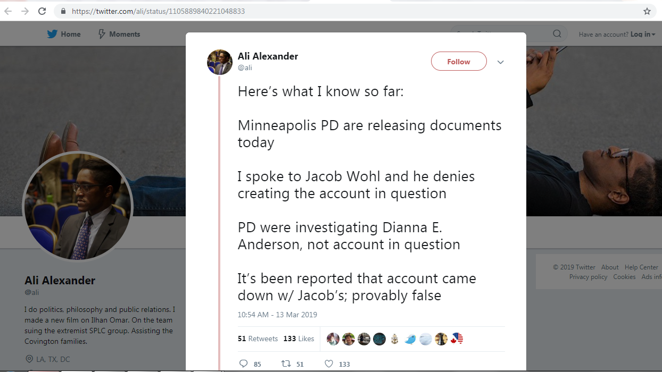
Source: https://twitter.com/ali/status/1105889840221048833

Slide 56
Events timeline slide from beginning to end
2018-12: @DrakeHomes612 account created
2019-01-24: @DrakeHomes612’s tweet mentions @JacobAWohl
2019-02-22: Wohl lands in Minneapolis for documentary
2019-02-22: Police looking in deaths threats to Wohl
2019-02-23: Wohl claims to be moving with security
2019-02-23: @ali tweets about death threats to himself and Wohl
2019-02-24: Wohl flies out of Minneapolis
2019-02-26: Twitter suspends Jacob Wohl over fake accounts
2019-02-26: Daily Beast reports @DrakeHomes612 as fake account of Jacob Wohl
2019-03-12: Documentary on @ilhan released
2019-03-13: Police released information to public about death threats

Slide 57
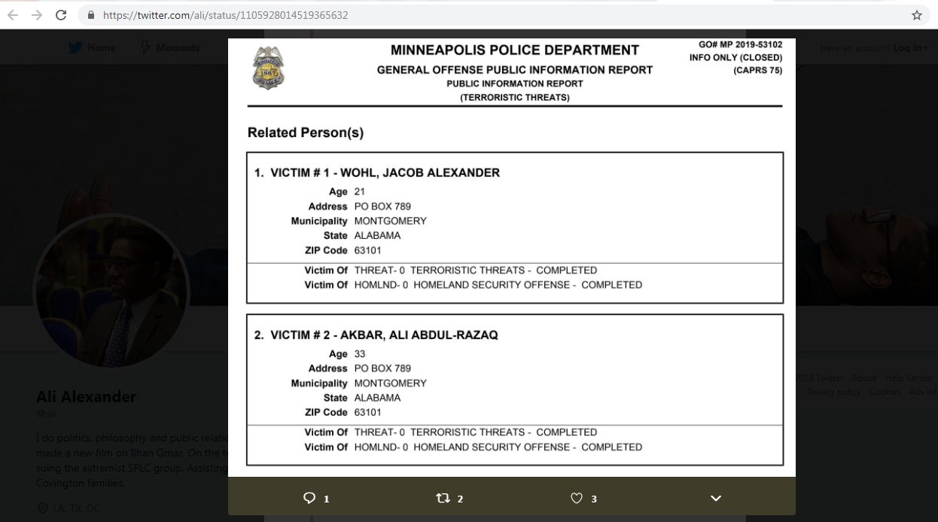
Screenshot of police report on the threat (Account created January 2019)
Source: https://twitter.com/ThePotenciado/status/1105973285353852928

